Slide 1

ST JOSEPH ENGINEERING COLLEGE An Autonomous Institution Department of Electronics and Communication Engineering TITLE OF THE PROJECT A sensor based system for detecting and approaching ambulance and controlling traffic signal
Name of the student 1 : Frenny Chrystal Saldanha USN: 4SO23EC028
Name of the student 2 : G J Chithara Hirinja USN: 4SO23EC029
Name of the student 3 : Kannika D Ambekallu USN: 4SO23EC043
Name of the student 4 : Kushi Salyan USN : 4SO23EC048
of

Slide 2
Contents
Introduction
Objectives
Methodology
Results and Discussion
Conclusion
Learning Outcomes
References

Slide 3
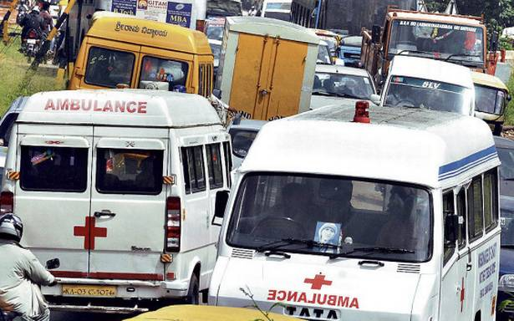
Introduction
The integration of emergency vehicle prioritization (EVP) systems with traffic signals plays a crucial role in improving the efficiency of emergency response times, particularly for ambulances.
Ambulance sirens are designed to alert other road users and traffic management systems to the presence of an emergency vehicle that needs to pass through traffic quickly.
However, traditional traffic signal systems can create delays for ambulances, especially in high-traffic urban areas.
So Here we have designed a model to control the traffic by using a sound sensor which senses the ambulance siren and stops all the vehicles in the traffic and lets the ambulance pass as soon as possible.
This Photo by Unknown Author is licensed under CC BY-NC

Slide 4
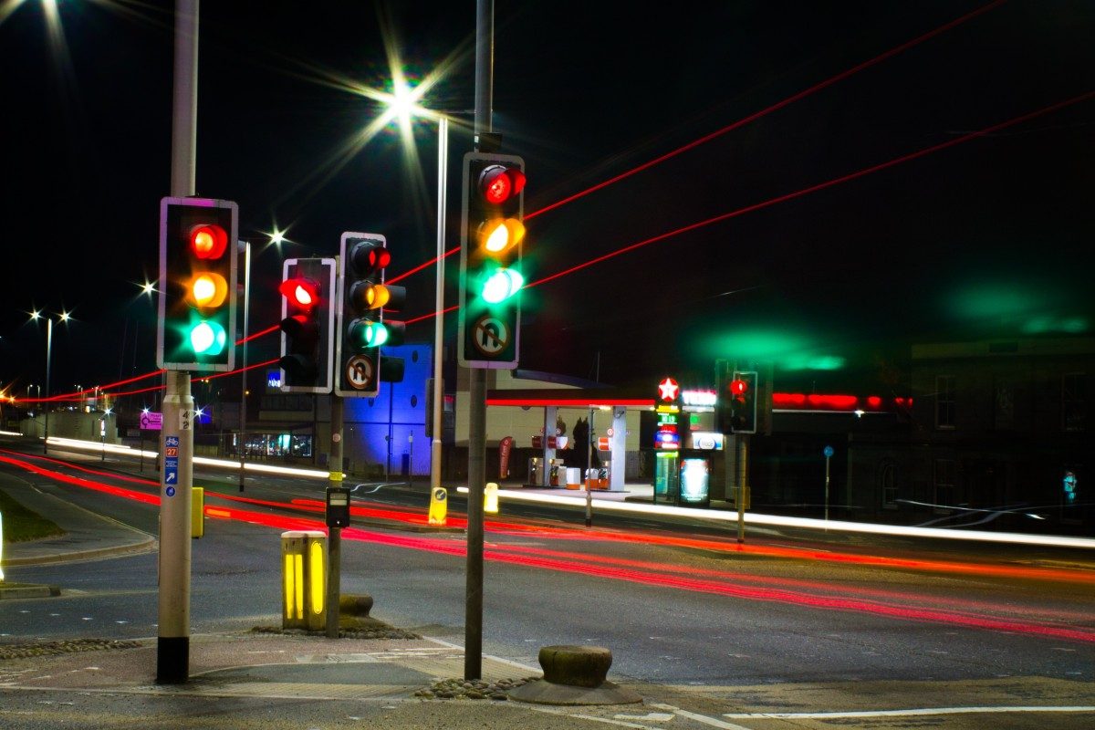
Objectives
The primary objective of this project is to improve the emergency response system, particularly for ambulances. When an ambulance is on its way to an emergency, every second counts.
In most traffic systems, the management of traffic lights is manually controlled, which are not responsive to real-time emergencies. Traffic police officers or road signs might provide some assistance, but these methods are prone to human error and delays, especially during high-traffic conditions.
By integrating a sound sensor and an Arduino Uno with existing traffic light systems, this project addresses the need for a real-time emergency response enhancement. This automated system reduces human error and delays, potentially saving lives.
The project uses a sound sensor to detect the siren of an ambulance in real-time. Once detected, the system communicates with an Arduino Uno to change the traffic light signals, allowing the ambulance to pass through intersections without delay.

Slide 5
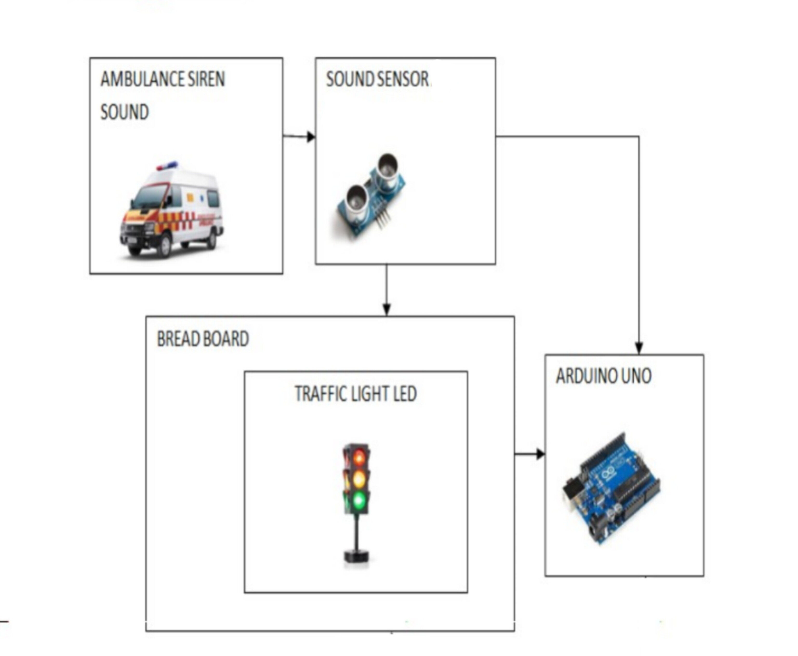
Methodology

Slide 6
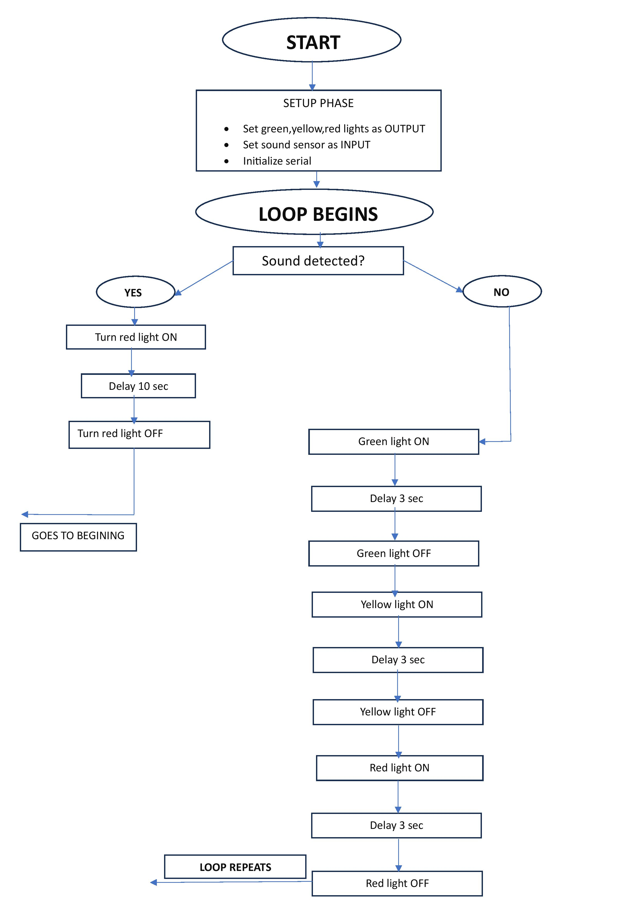

Slide 7
Results and Discussion
Performance Evaluation:
The accuracy of sound detection varied depending on ambient noise levels, but in most cases, the system functioned effectively
Traffic Light Override:
Successfully overrode the regular traffic light cycle, turning the red light on for the traffic vehicles.
Reduced Waiting Time for Emergency Vehicles:
On average, the response time was reduced by 40-60%, which directly contributed to a faster response time for emergency services. This improvement is critical for saving lives, especially in situations where every second counts.
Impact on Regular Traffic:
Although the system temporarily halts the regular traffic cycle when an ambulance is detected, the impact on regular traffic flow was minimal.
Wireless Communication:
wireless communication between sensors at multiple intersections. This would ensure that the entire route of the ambulance is cleared in advance, rather than only the immediate intersection where the system is located.

Slide 8
Conclusion
The Ambulance Detection and Traffic Light Integration System proved to be an effective solution for enhancing the prioritization of emergency vehicles at intersections.
The system achieved its goal of reducing delays for ambulances by detecting their sirens and adjusting traffic signals in real-time.
While challenges related to noise interference and sensor range were observed, the system demonstrated strong potential for improving emergency response times.
The project laid the groundwork for more sophisticated, scalable traffic management solutions that could be deployed in smart cities. With further refinement, including the use of advanced signal processing, multiple sensors, and integration with smart traffic management systems, this system has the potential to greatly enhance urban traffic flow and emergency vehicle prioritization in the future.

Slide 9
Learning Outcomes
Microcontroller Programming: The project gave an in-depth understanding of programming a microcontroller (Arduino Uno) to handle real-time input/output operations. Specifically, it involved reading inputs from a sound sensor, processing the data, and controlling output devices like traffic light relays.
Control Flow and Decision Making: The project involved creating logic to detect the siren sound and change traffic light states accordingly. This required designing a decision-making structure where the Arduino checks for the siren detection and switches between traffic light states (e.g., green to red) based on the detection.
Signal Processing: The system involved an interface between hardware (sound sensor) and software (Arduino code). It helped understand how sensors provide analog signals, which are then converted into digital data that the microcontroller can process to trigger actions like controlling relays.
System Architecture Design: The project required thinking about the network architecture of how the sound sensor communicates with the Arduino and how the Arduino controls the relays. This required a basic understanding of signal propagation, feedback loops, and the impact of adding components in a distributed system.

Slide 10
Learning Outcomes
Synchronous Operation of Multiple Components: While this specific project did not implement large-scale networking, it required a synchronization of real-time actions, such as sensor reading, decision-making, and actuator control.
Scalability of the System: The project gave insights into how the system could be expanded by adding multiple sensors across larger intersections or multiple locations, creating a network of connected sensors.
Understanding Sensor Response: The sound sensor used in this project responded to varying sound intensities by providing an analog output. By experimenting with different sounds (like sirens and background noise), it was important to learn how sensors behave in analog circuits and how voltage levels correlate with real-world phenomena like sound intensity.
Noise Filtering and Signal Conditioning: The project highlighted the importance of signal conditioning to improve sensor accuracy. For example, ensuring the sound sensor’s analog output is processed cleanly without distortion by ambient noise was a key learning aspect.

Slide 11
References
Linna Wu, Huan Li, Feng Ren, Lizhuo Zhang, IoT-enabled traffic analysis, Proceedings of International Conference on Internet of Things Design and Implementation ACM, April 2019.
Gulnur Tolebi, Daniyar KurmanKhojayev, Nurlan S.Dairbekov, Proceedings of 5th International Conference on Engineering and MIS, Road traffic demand estimation and traffic signal control, ACM, June 2019.
Arduino(2019)millis().https://www.arduino.cc/reference/en/language/functions/time/millis/. Accessed 5 June 2019
ShivaPrasad K S, Shruthi S, Chandana R Nayaka, Arun Y K. “Advanced Traffic Control System for Emergency Vehicle”. International Journal of Engineering Research & Technology (IJERT) ISSN: 2278-0181 Published by, www.ijert.org NCESC - 2018 Conference Proceedings.

Slide 12
THANK YOU

